Slide 1
Python Program for Merge Sort
Merge Sort is a Divide and Conquer algorithm. It divides input array in two halves, calls itself for the two halves and then merges the two sorted halves.
The merge() function is used for merging two halves. The merge(arr, l, m, r) is key process that assumes that arr[l..m] and arr[m+1..r] are sorted and merges the two sorted sub-arrays into one.
Python Program for Merge Sort
The provided Python code implements the Merge Sort algorithm, a divide-and-conquer sorting technique. It breaks down an array into smaller subarrays, sorts them individually, and then merges them back together to create a sorted array. The code includes two main functions: merge, responsible for merging two subarrays, and mergeSort, which recursively divides and sorts the array. The merge function combines two sorted subarrays into a single sorted array. The mergeSort function recursively splits the array in half until each subarray has a single element, then merges them to achieve the final sorted result. The example sorts an array using Merge Sort and prints both the initial and sorted arrays.

Slide 2
Introduction to Divide and Conquer Algorithm
Divide and Conquer Algorithm is a problem-solving technique used to solve problems by dividing the main problem into subproblems, solving them individually and then merging them to find solution to the original problem. In this article, we are going to discuss how Divide and Conquer Algorithm is helpful and how we can use it to solve problems.

Slide 3
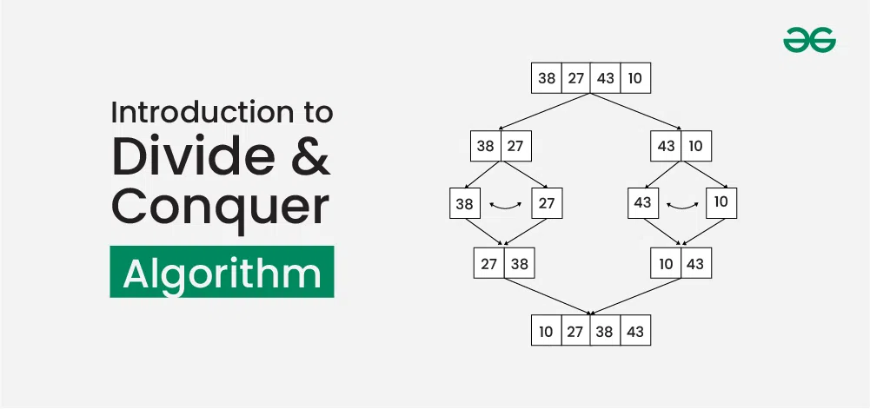

Slide 4
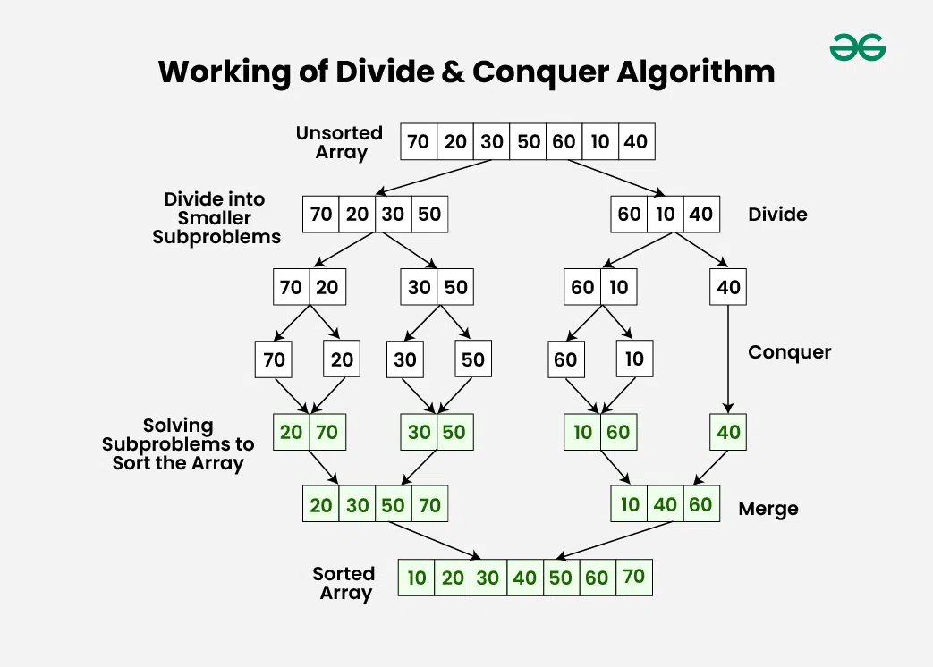
Working of Divide and Conquer Algorithm:
Divide and Conquer Algorithm can be divided into three steps: Divide, Conquer and Merge .

Slide 5
1. Divide:
Break down the original problem into smaller subproblems.
Each subproblem should represent a part of the overall problem.
The goal is to divide the problem until no further division is possible.
2. Conquer:
Solve each of the smaller subproblems individually.
If a subproblem is small enough (often referred to as the “base case”), we solve it directly without further recursion.
The goal is to find solutions for these subproblems independently.
3. Merge:
Combine the sub-problems to get the final solution of the whole problem.
Once the smaller subproblems are solved, we recursively combine their solutions to get the solution of larger problem.
The goal is to formulate a solution for the original problem by merging the results from the subproblems.

Slide 6
Python Program for QuickSort
Just like merge Sort, QuickSort is a divide and conquer algorithm. It picks an element as a pivot and partitions the given array around the picked pivot.
There are many different versions of quickSort that pick pivot in different ways.
Always pick the first element as a pivot
Always pick the last element as a pivot
Pick a random element as a pivot
Pick median as a pivot
Here we will be picking the last element as a pivot. The key process in quickSort is partition(). Target of partitions is, given an array and an element ‘x’ of array as a pivot, put x at its correct position in a sorted array and put all smaller elements (smaller than x) before x, and put all greater elements (greater than x) after x. All this should be done in linear time.

